Slide 1


Data Visualisation of Marginal Workers in Tamil Nadu
In this presentation, we will explore the world of marginal workers in Tamil Nadu and how data visualisation can be a powerful tool for advocacy and policy change.

Slide 2

Who Are Marginal Workers in Tamil Nadu?
1
Definition
2
Scope
Workers with irregular and precarious jobs in low-paying sectors such as agriculture, construction, and domestic work.
They make up 10% of Tamil Nadu's workforce and are often excluded from social benefits and legal protections.
3
Challenges
Face barriers to social mobility and suffer from poor working conditions, low wages, and exploitation.

Slide 3
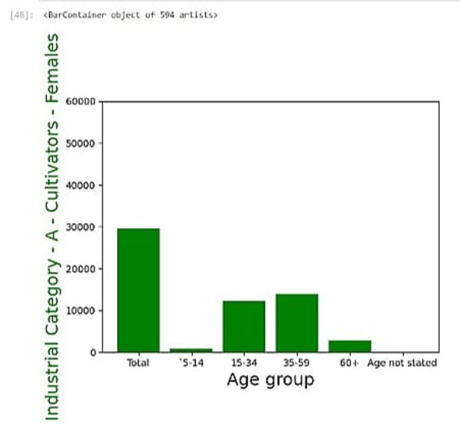
Data Collection and Analysis Methods
In-Depth Interviews
Secondary Data Analysis
Conducted with 100 marginal workers in Tamil Nadu to understand their experiences and challenges.
Reviewed government reports, academic studies, and news articles to identify trends and patterns.

Slide 4
Key Findings About Marginal Workers in Tamil Nadu
Vulnerability
Gender Disparities
69% reported being unable to afford basic necessities such as food and housing.
Women face more discrimination and earn lower wages than men in the labor force.
Health Hazards
Exploitation
70% complained of work-related health problems such as headaches, back pain, and respiratory issues.
60% faced exploitation through low wages, long hours, and lack of job security.

Slide 5
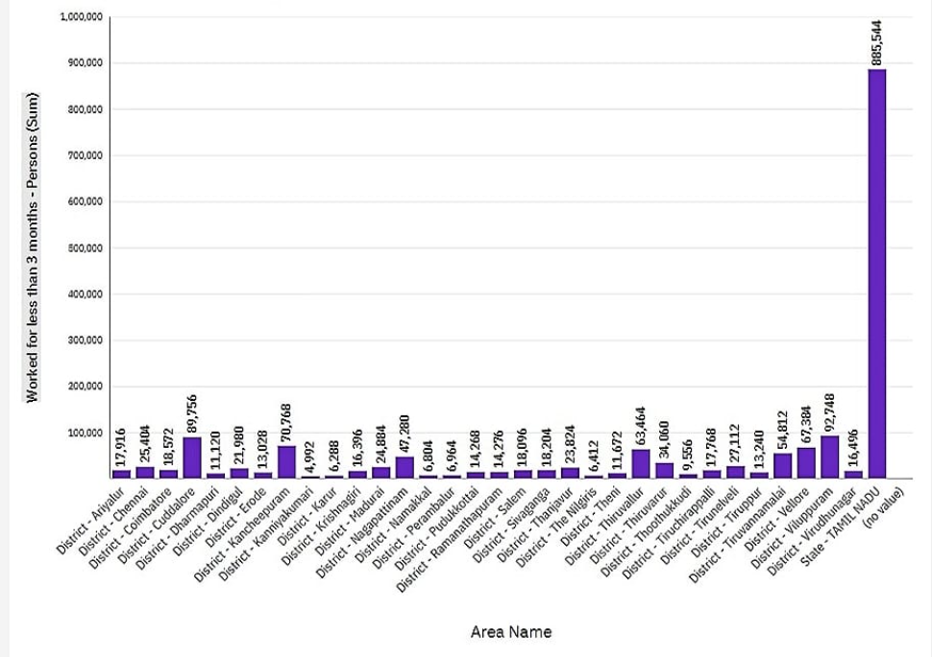
Overview of Data Visualisation Techniques Used
1
Infographics
Created visual representations of key statistics and findings to help make them more accessible to policymakers.
Heat Maps
2
Used color coding to highlight geographic patterns in marginal work and the areas where they are most vulnerable.
3
Interactive Dashboards
Developed dynamic online platforms that policymakers and stakeholders can use to see data and trends with more granularity.

Slide 6
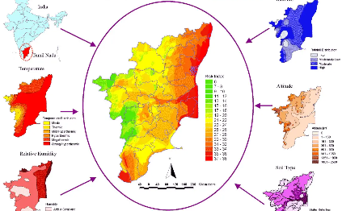

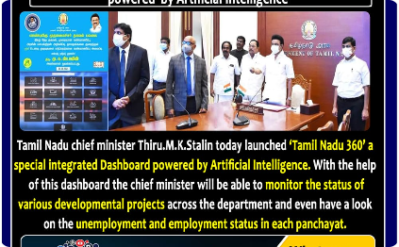
Examples of Data Visualisations for Marginal Workers in Tamil Nadu
Heat Map of Marginal Workers in Tamil Nadu
Infographic on Marginal Workers in Tamil Nadu
Interactive Dashboard of Marginal Workers in Tamil Nadu
Shows the locations where marginal workers are most concentrated, highlighting the need for targeted policy interventions.
Visually presents key data and statistics in a clear and compelling way to raise awareness about the urgent need for policy change.
Allows policymakers to drill down into the data and see trends over time, making it easier to assess progress and identify gaps.

Slide 7

Impact of Data Visualisation on Policy and Advocacy Efforts
1
Increased Awareness
2
Improved Decision-Making
Data visualisation has helped to bring attention to the plight of marginal workers and the need for policy reforms.
Policymakers now have more data-driven insights on how to better target interventions and improve the lives of marginal workers.
3
Engaged Stakeholders
NGOs, activists, and other stakeholders have been able to use data visualisation to mobilize support and advocacy efforts for marginal workers.

Slide 8

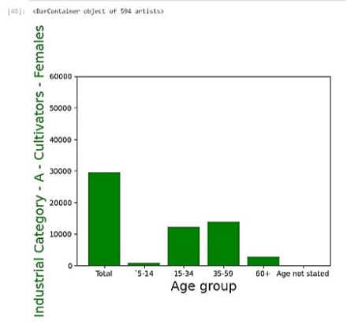
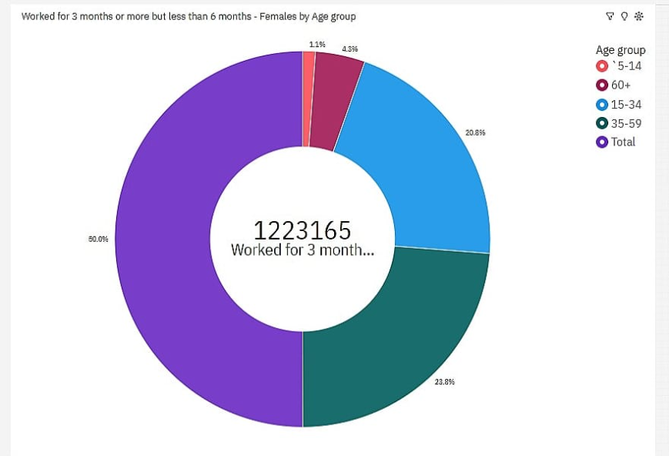
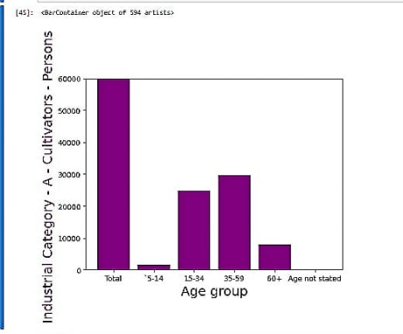
Conclusion and Future Directions
Call to Action
Continued Research
Urge policymakers to prioritize policy reforms that will help to protect and empower marginal workers in Tamil Nadu.
Further data collection and analysis is needed to refine our understanding of this group and their experiences.

